Slide 1

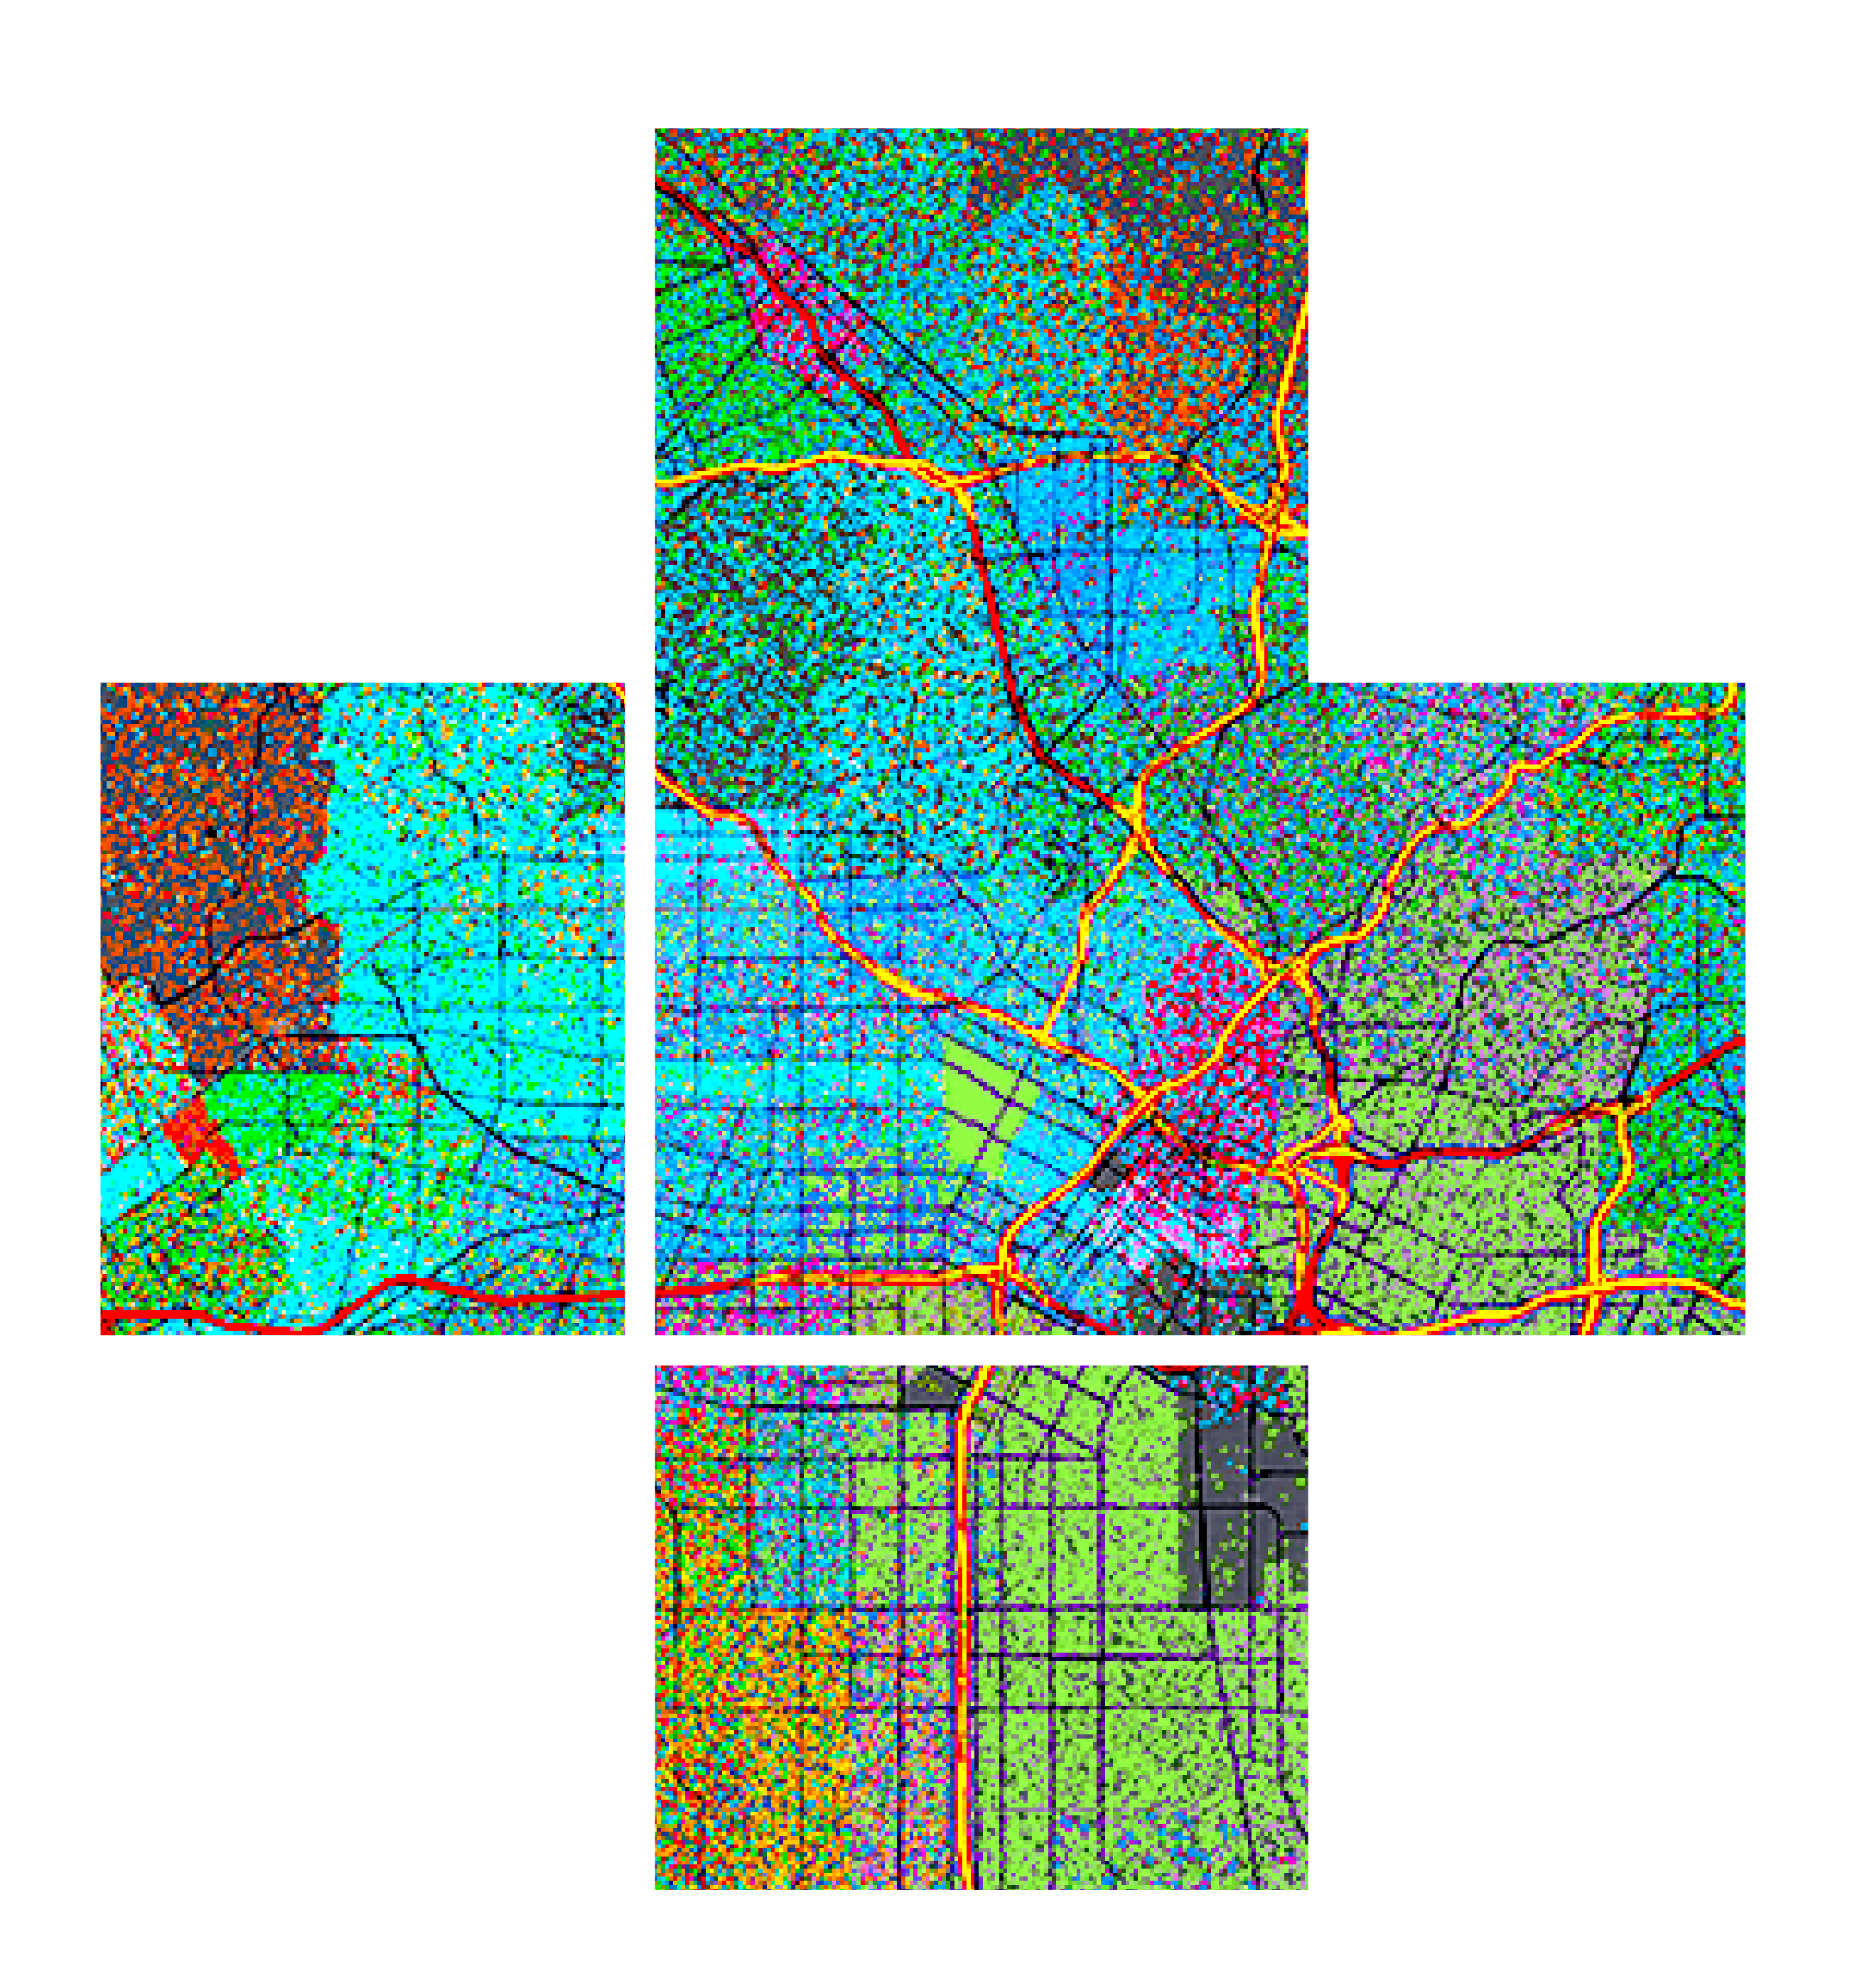








ArcGIS API for JavaScript: Creating Custom Layers and Layer Views
Please leave artwork “+” clustered.
Do not use them alone, as bullet points, or as a “plus” concept. Thank you.
Jacob Wasilkowski @JWasilGeo
2020 ESRI DEVELOPER SUMMIT | Palm Springs, CA

Slide 2





Agenda
Intro to custom Layers and LayerViews in JSAPI 4.x
Examples and demos
Deep dive into a custom visualization for a 2D MapView

Slide 3


Finding Our Way
Where to begin making custom Layers and Layer Views

Slide 4
Extending JSAPI 4.x with a custom “Layer”
Custom Layer 2D MapView & 3D SceneView
BaseDynamicLayer esri/layers/ BaseDynamicLayer
BaseElevationLayer esri/layers/ BaseElevationLayer
BaseTileLayer esri/layers/ BaseTileLayer

Slide 5
Extending JSAPI 4.x with a custom “Layer”
Layers are for data access; they do not have direct visual representation
Why create a custom layer?
To connect to a service not supported (yet) by the JSAPI
To manipulate data client-side before it is displayed in a 2D MapView or 3D SceneView
To mash up multiple services to create new visualizations
Limitations
Suited for static content
No control over when it redraws
Limited to image formats and tiles

Slide 6
Extending JSAPI 4.x with a custom “LayerView”
Custom LayerView 2D MapView only
BaseLayerView2D esri/views/2d/layers/ BaseLayerView2D
BaseLayerViewGL2D esri/views/2d/layers/ BaseLayerViewGL2D

Slide 7
Extending JSAPI 4.x with a custom “LayerView”
2D MapView only
Represents the view of a Layer after it has been added to a Map
Responsible for calling a Layer’s API to get data and redraw
Canvas API or WebGL API is exposed to draw anything you want in a 2D MapView

Slide 8
Extending JSAPI 4.x with custom “externalRenderers”
Custom externalRenderers 3D SceneView only
externalRenderers esri/views/3d/ externalRenderers

Slide 9
Extending JSAPI 4.x with custom “externalRenderers”
3D SceneView only
WebGL API is exposed to draw anything you want in a 3D SceneView

Slide 10
Demos & Code
Enough words, more pictures

Slide 11
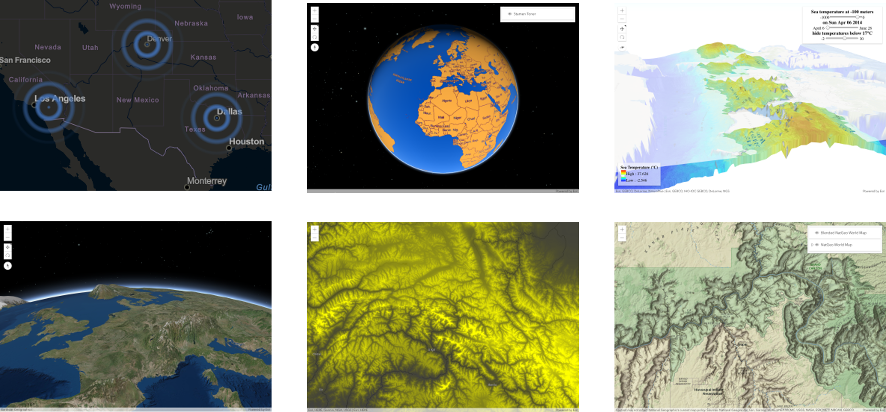
Examples of what’s possible: https://esriurl.com/jsCustomLayers

Slide 12
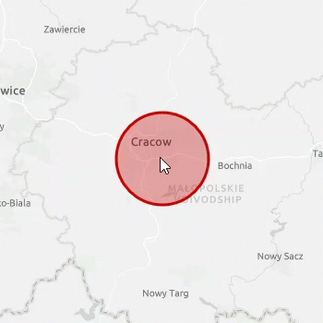

Demo
A deep dive into making a custom and animated BaseLayerView2D
Review a simple GraphicsLayer
Create a static BaseLayerView2D
Animate it!
https://github.com/jwasilgeo/esri-experiments

Slide 13
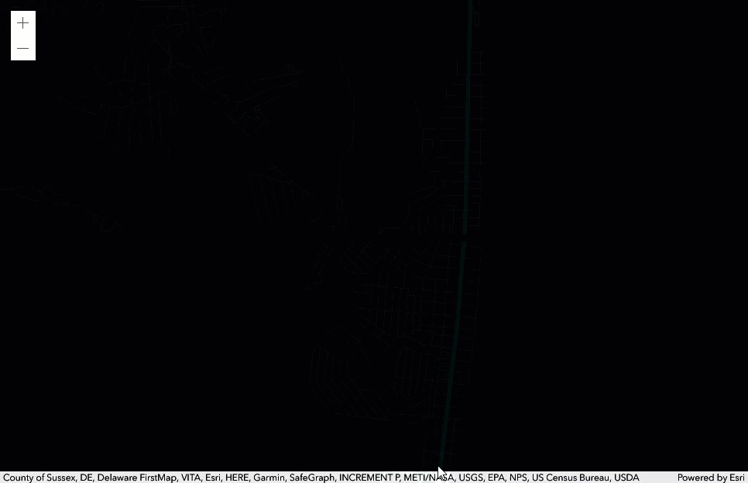
Demo
A custom BaseLayerView2D made by Sean McGee
https://codepen.io/smcgee/pen/KKpKPxW
@HertsWestUK

Slide 14
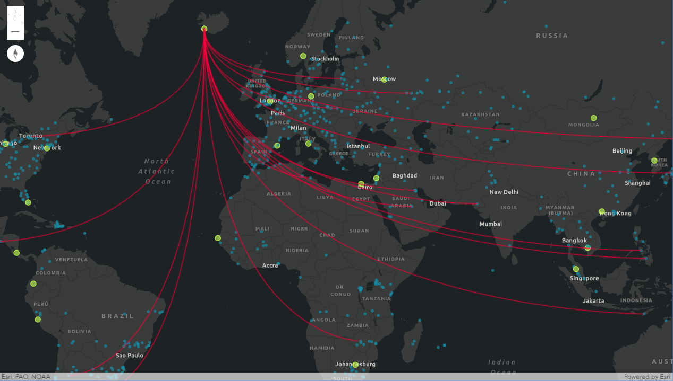
Demo
“Canvas-Flowmap-Layer”
A custom BaseLayerView2D made in collaboration with Sarah Bell
@sarahbellmaps
https://github.com/sarahbellum/Canvas-Flowmap-Layer

Slide 15
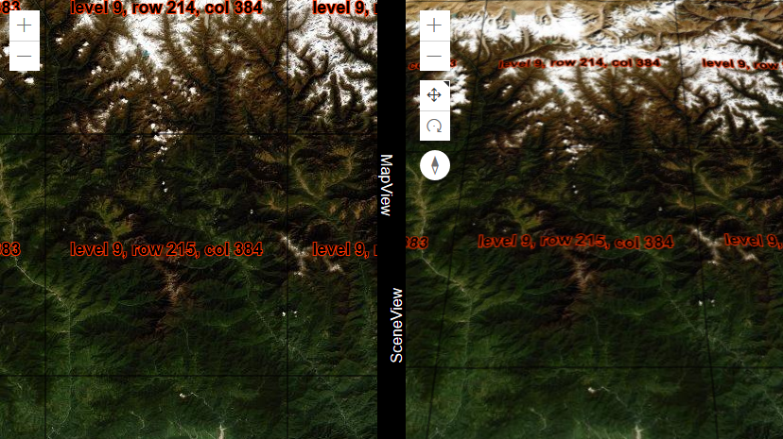
Demo
Making a custom
BaseTileLayer
https://github.com/jwasilgeo/esri-experiments

Slide 16

Demo
“Earth at Night, Mountains of Light”
Built with a custom BaseElevationLayer
https://jwasilgeo.github.io/esri-experiments/earth-at-night/

Slide 17
Resources
These slides will be available at
Esri Proceedings webpage
https://github.com/jwasilgeo/presentations
Blog post about “Earth at Night, Mountains of Light”
https://petrichor.studio/2019/02/14/earth-at-night-mountains-of-light/
Dev Summit 2019: “ArcGIS API for JavaScript: Creating Custom Layers and Layer Views”
https://proceedings.esri.com/library/userconf/devsummit19/papers/DevSummitPS_10.pdf
Dev Summit 2018: “ArcGIS API for JavaScript: Creating Custom Layers”
https://proceedings.esri.com/library/userconf/devsummit18/papers/dev-int-018.pdf

Slide 18
Thank you!
Please leave artwork “+” clustered.
Do not use them alone, as bullet points, or as a “plus” concept. Thank you.
Jacob Wasilkowski @JWasilGeo
2020 ESRI DEVELOPER SUMMIT | Palm Springs, CA

